Slide 1
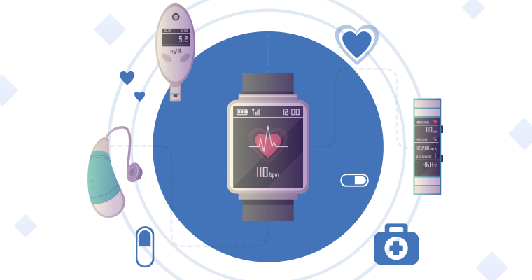
Exploring Drowsiness Patterns in Wearable Device Data

Slide 2
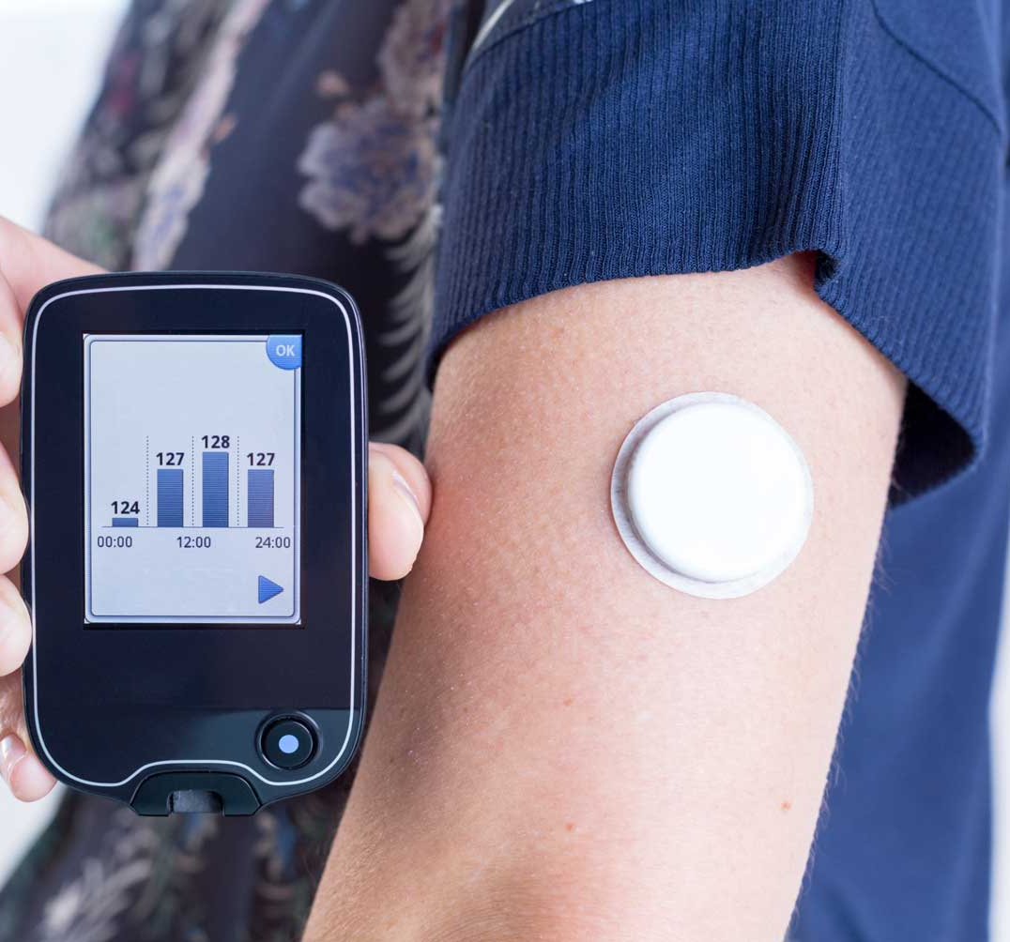
Table of content
Agenda of the Analysis
Data Description
Exploratory Data Analysis
Statistical Analysis
Recommendations
Conclusion

Slide 3
AGENDA
Analyze data
Evaluate Trends
Exploring the relationship between physiological parameters and drowsiness levels
Evaluate Trends to Uncover patterns and insights from the dataset
Identifying key features
Identify Key Features and Trends to understand the data.

Slide 4
DATA INTRODUCTION
The dataset was created using a Galaxy Watch4 smartwatch vital signs sensors. Data were collected from heart rate and PPG sensors (PPG includes 3 variations, green, red and infrared). The 'drowsiness' column refers to the label assigned by the user based on an adaptation of the Karolinska Sleepiness Scale (KSS)

Slide 5
DATA DESCRIPTION
COLUMNS | DESCRIPTION
heartrate | Heart rate readings from the smartwatch sensors.
ppgGreen | PPG (Photoplethysmography) sensor readings in green wavelength
ppgred | PPG (Photoplethysmography) sensor readings in red wavelength
ppgIR | PPG (Photoplethysmography) sensor readings in infrared wavelength
drowsiness | Label indicating the level of drowsiness based on an adapted Karolinska Sleepiness Scale (KSS). Values range from 0.0 to 2.0, where 0.0 represents alertness and 2.0 represents significant drowsiness.

Slide 6
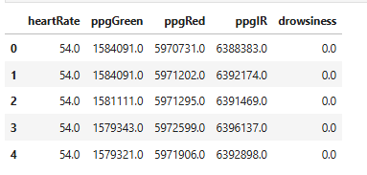
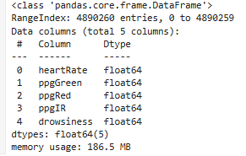
DATA SUMMARY
This dataset contains only 1file with 5 columns and 4890259 entries(rows).
All the columns are of same data type- float64.
This data has in total 2494973 duplicate values but no null/missing values.

Slide 7

EXPLORATORY DATA ANALYSIS

Slide 8
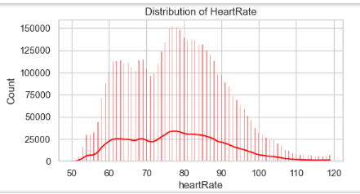
DISTRIBUTION OF DROWSINESS CASES
As we can see the most heart rate range lies btw 60-90.
Highest peak of graph is between 70-80, which means most of the people have heart rate btw70-80.
Shape of distribution is right skewed. (HR above 90 are very common) (very few people have it btw 100-120.

Slide 9
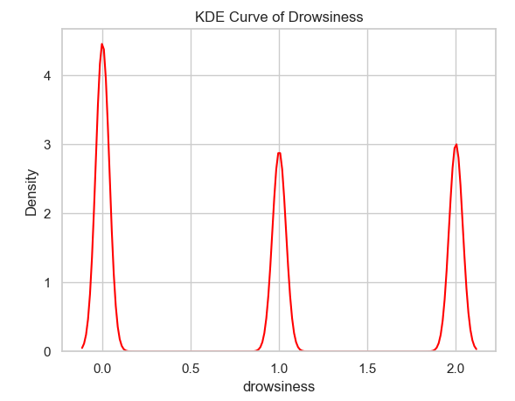
KDE CURVE OF DROWSINESS
Here, 0 means no drowsiness, 1 means moderate, 2 means high drowsiness.
Now the graphs shows only 3 distinct bar, because it grouped the values into bins.
The KDE curve which is btw 0.2 till 1 and then till 2 (close to 0)shows that there are only few data points which lie here.

Slide 10
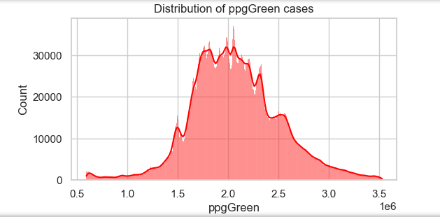
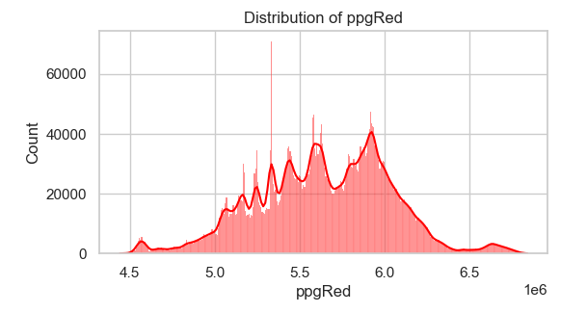
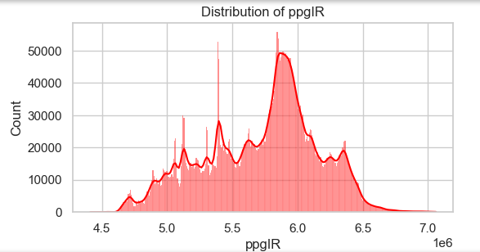
DISTRIBUTION OF PPG SIGNALS
Slightly right skewed
Following normal distribution
High peak is observed around 2.0e6 which means green light detected similar signal values for the majority of the cases.
Positively skewed
High peak is observed around 5.3e6 which means that the majority of red signal values are clustered around this range
Some small spikes could be due to more variability.
Positively skewed
High peak is observed around 6.0e6 which means most of the infrared signal values are concentrated here.
Smaller hikes represents few variations in the readings which could be seen due to changes in blood flow or something else.

Slide 11

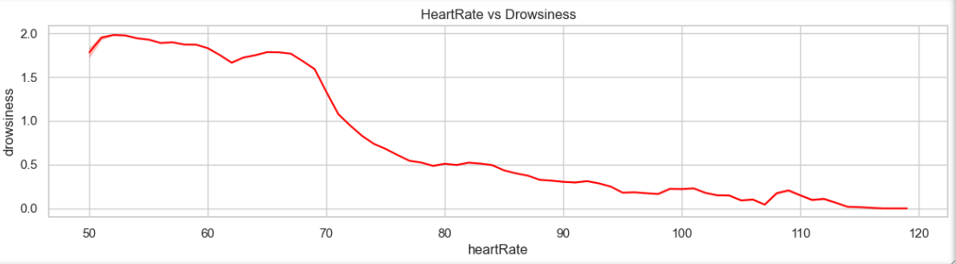
LINE PLOT BETWEEN HEARTRATE AND DROWSINESS
Heartrate has highly negative correlation with drowsiness (which means, when heart rate increases drowsiness decreases and vice versa)

Slide 12

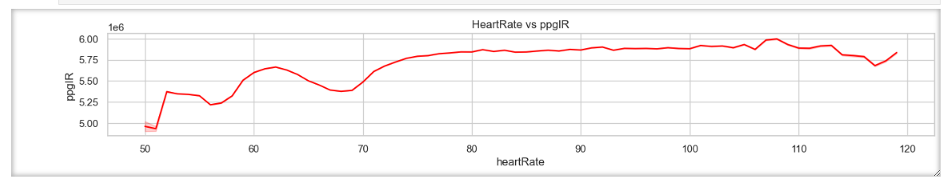
LINE PLOT BETWEEN HEARTRATE AND PPG INFRA RED SIGNALS
After checking the correlation of heartrate with green signal it was 0.0085 which is almost negligible and red signal it was 0.32 which is less than 0.34 i.e. Infrared signal . so I choose Infra red signal as it has stronger relation than red and green.

Slide 13

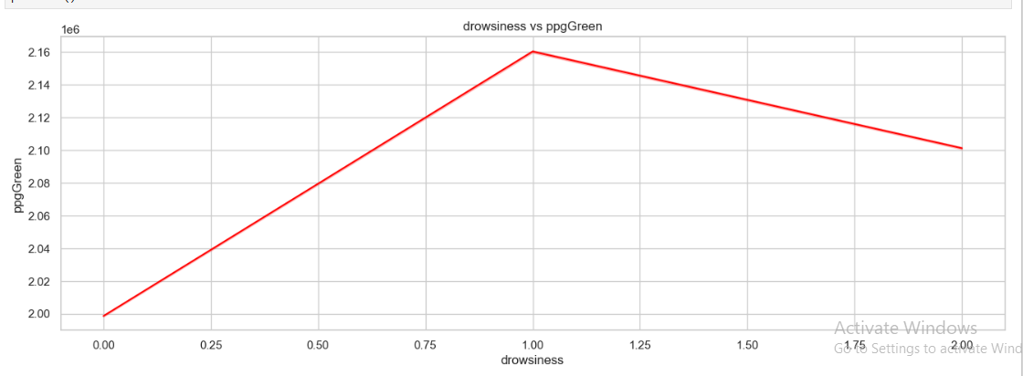
LINE PLOT BETWEEN DROWSINESS AND PPG GREEN SIGNALS
As per this graph, the correlation value shows a very weak positive correlation.
As green signal becomes stronger , drowsiness increases in early stage.
After a peak at drowsiness=1, green signal begins to decrease gradually.

Slide 14

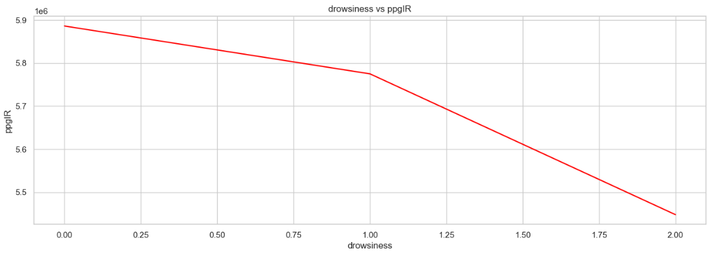
LINE PLOT BETWEEN DROWSINESS AND PPG INFRARED SIGNALS
As per this graph, it is same as red light, but when person is in moderate drowsiness, there is a sudden fall in infra red signal.
As per the correlation, red light has correlation value as -0.39 which has little less negative correlation with drowsiness than InfraRed.

Slide 15
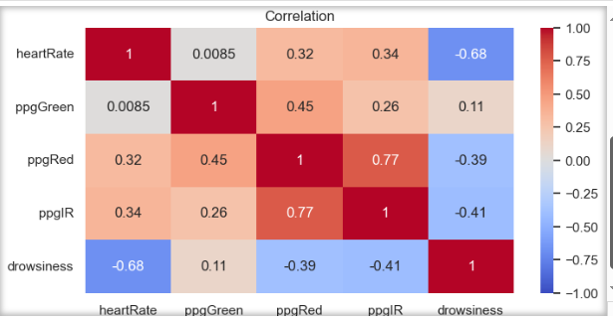
HEATMAP(COVARIANCE MATRIX)
Heart Rate shows the strongest negative correlation with drowsiness.
PpgIR and PpgRed also have moderate negative correlation with drowsiness.
PpgGreen has a very weak positive correlation with drowsiness, making it less relevant.

Slide 16

STATISTICAL ANALYSIS

Slide 17
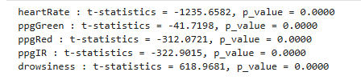
T- TEST
Heartrate, ppgIR, ppgRed having the highest negative values are showing the strongest relationships with drowsiness.
PpgGreen has a much smaller t-statistics , indicating a weaker relationship.
All variables having 0 p-value means that their relationships with dependent variable (drowsiness) is highly important.

Slide 18
CHI2 TEST BETWEEN DROWSINESS AND HEARTRATE
The high value of chi-square test suggests that these two variables are strongly associated and not independent.
P-Value =0 means, that the result is highly statistically significant not by any random chance.
Degree of freedom tells that we had 2 rows and columns.(2-1)*(2-1)=1

Slide 19

RECOMMENDATIONS
After the whole data analysis, I would like to suggest there should be an alert alarm in few cases-
When person is sleepy or in rest mode (drowsiness=2) heartrate should be below 100. If it’s high, person should be alerted at the same time.
When heartrate is below 50 , at that time also person should be alerted as this is not a normal heartrate.

Slide 20

THANK YOU
MABE BY-
MUSKAN MUSKAN

